Slide 1
清华大学创客交叉融合空间（i-Center）
Tsinghua Maker Space: i-Center
基础工业训练中心，工业工程系，美院，教务处
Fundamental Industry Training Center
Dept. of Industrial Engineering, Academy of Art and Design
Office of Academic Affairs, Tsinghua University

Slide 2

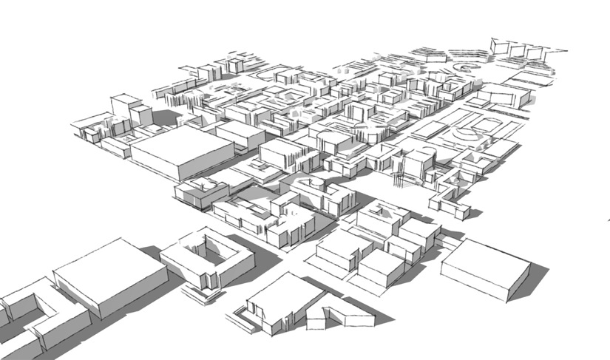
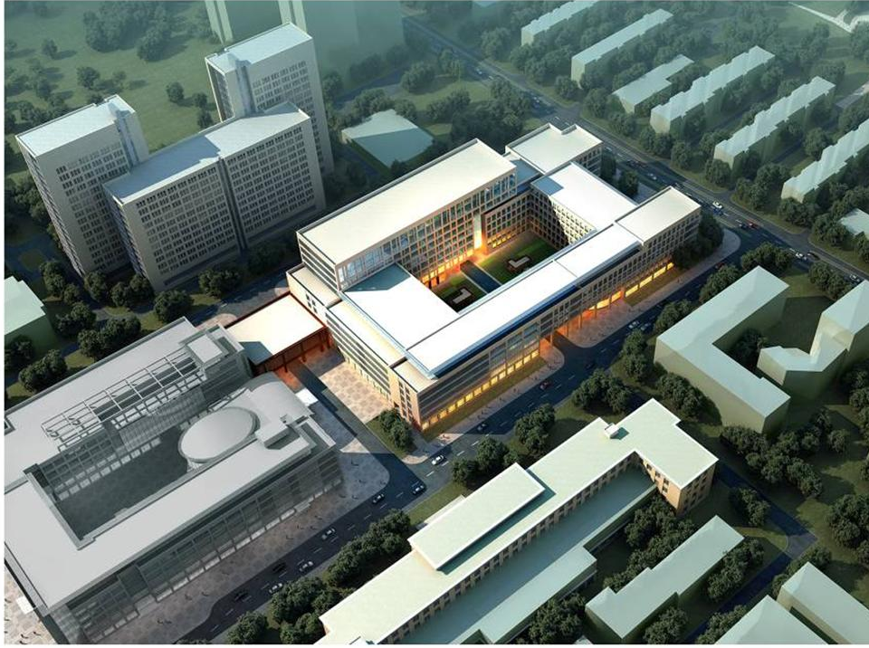
Mission: Dream Maker
Platform for all in Tsinghua to provide Idea Realization Service
Including engineering, science, art, social science etc.
Top quality practical education resources, supporting ecology of Idea, Innovation, and Entrepreneurship.
Fundamental engineering training
Systematical innovation thinking training
Prototype development
Product incubation
Technology
Knowledge
Society
Presentation
initiative
innovation
interdisciplinary
industry
Academics
Industry
Collaborative Learning

Slide 3
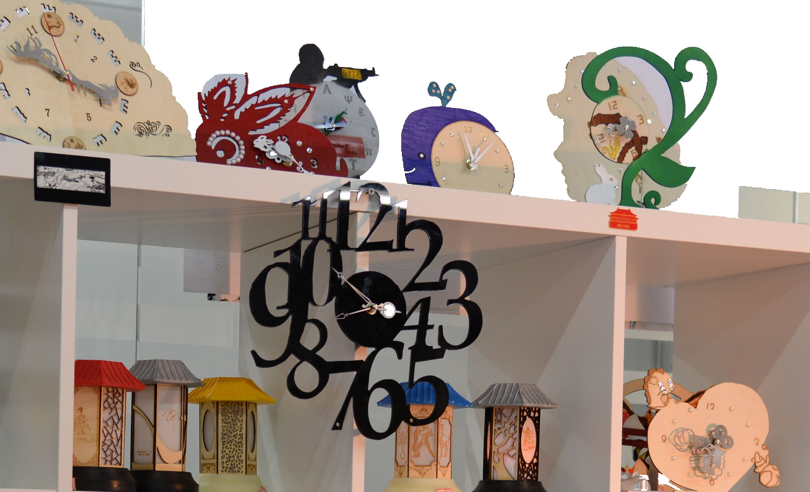
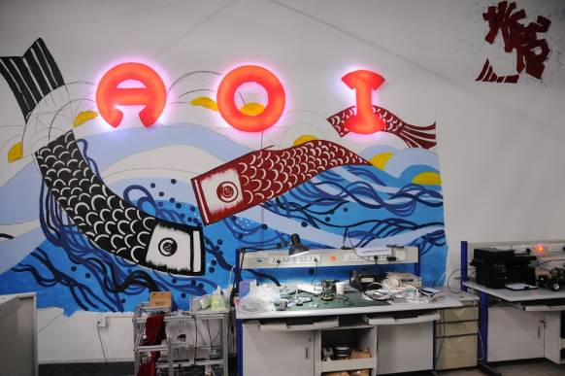
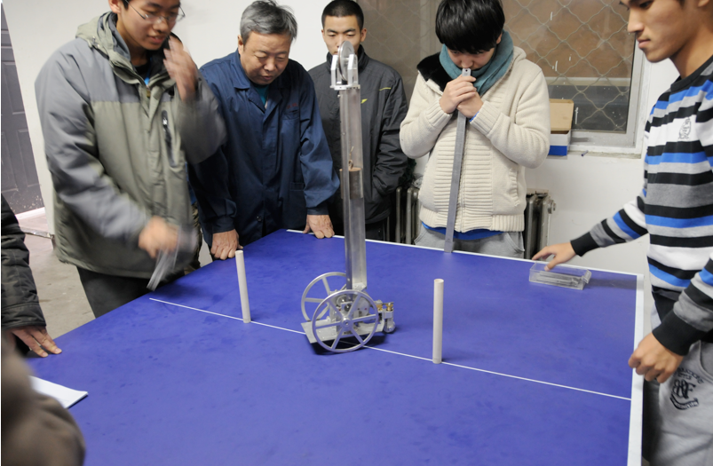
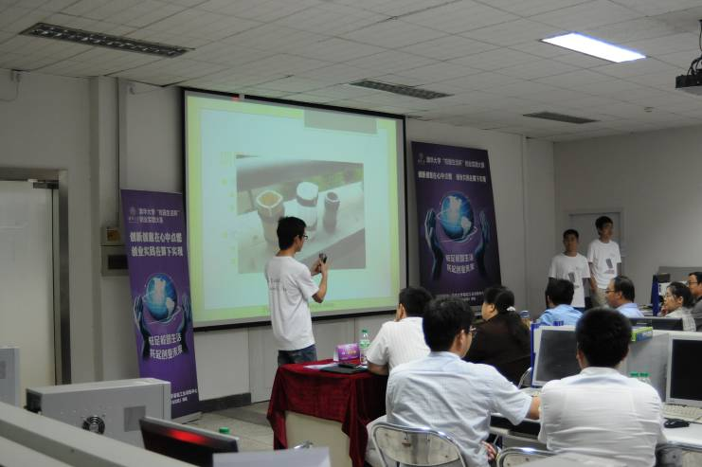
Prototyping
Student Club
Engineering Challenge
Entrepreneurship

Slide 4
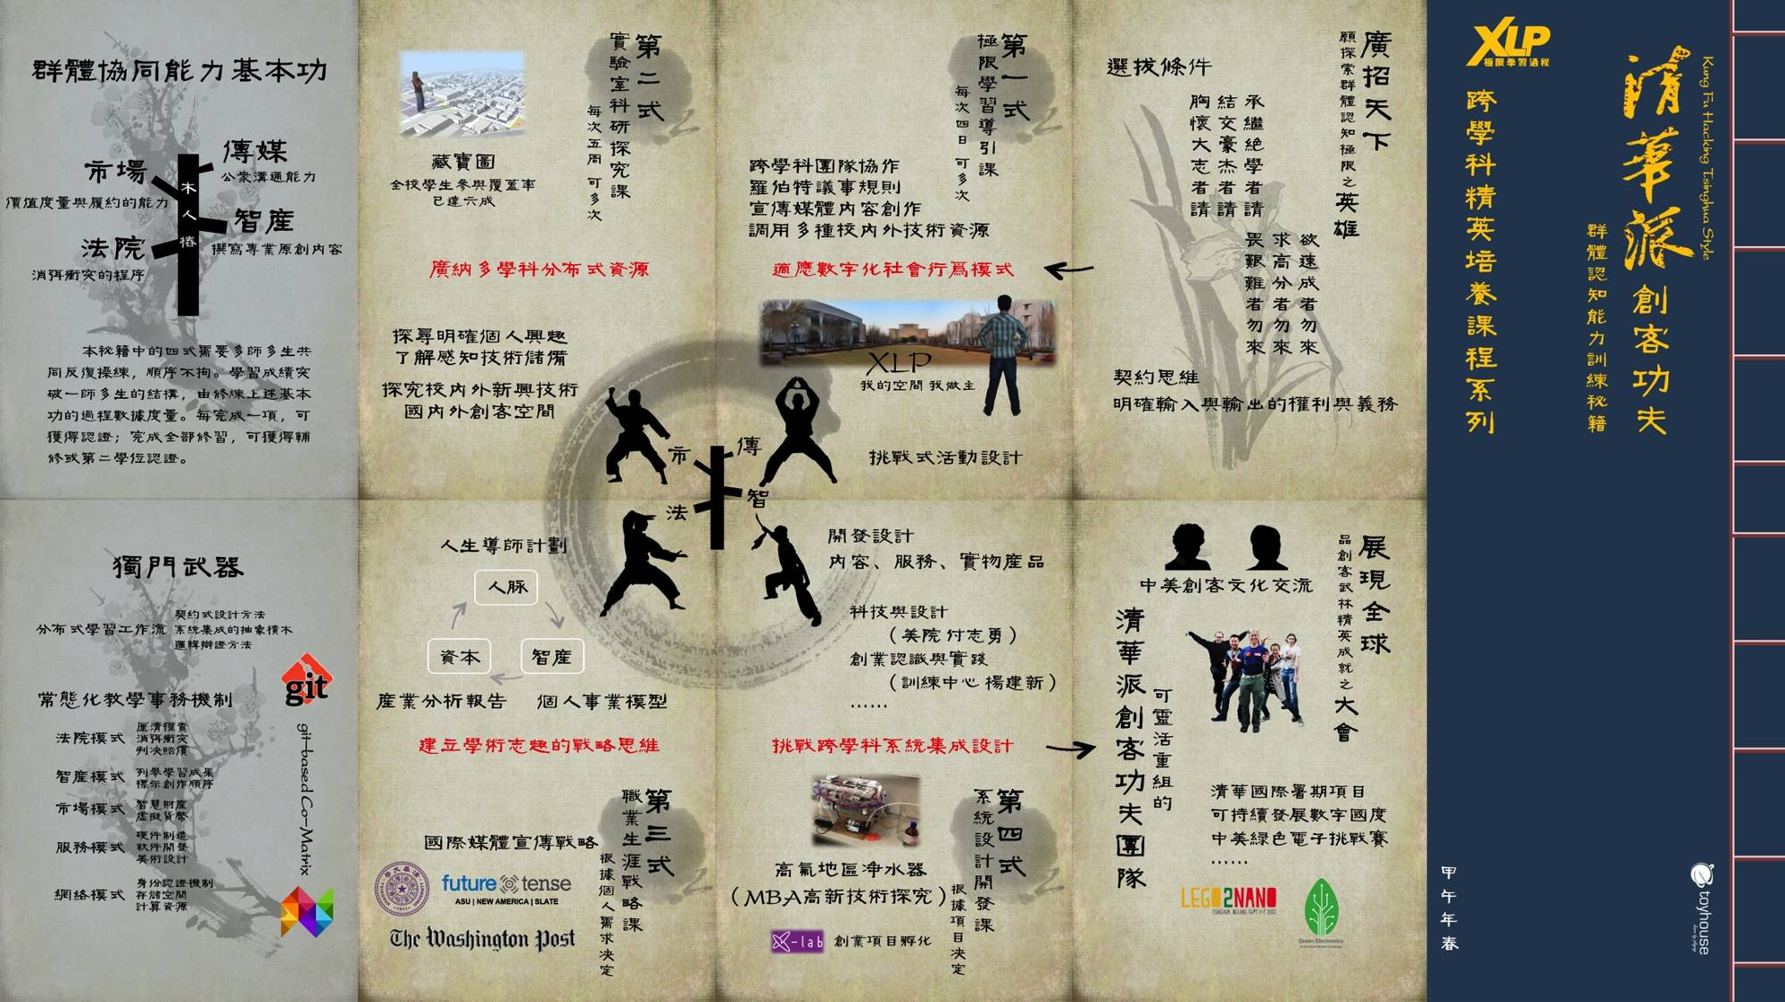

Slide 5
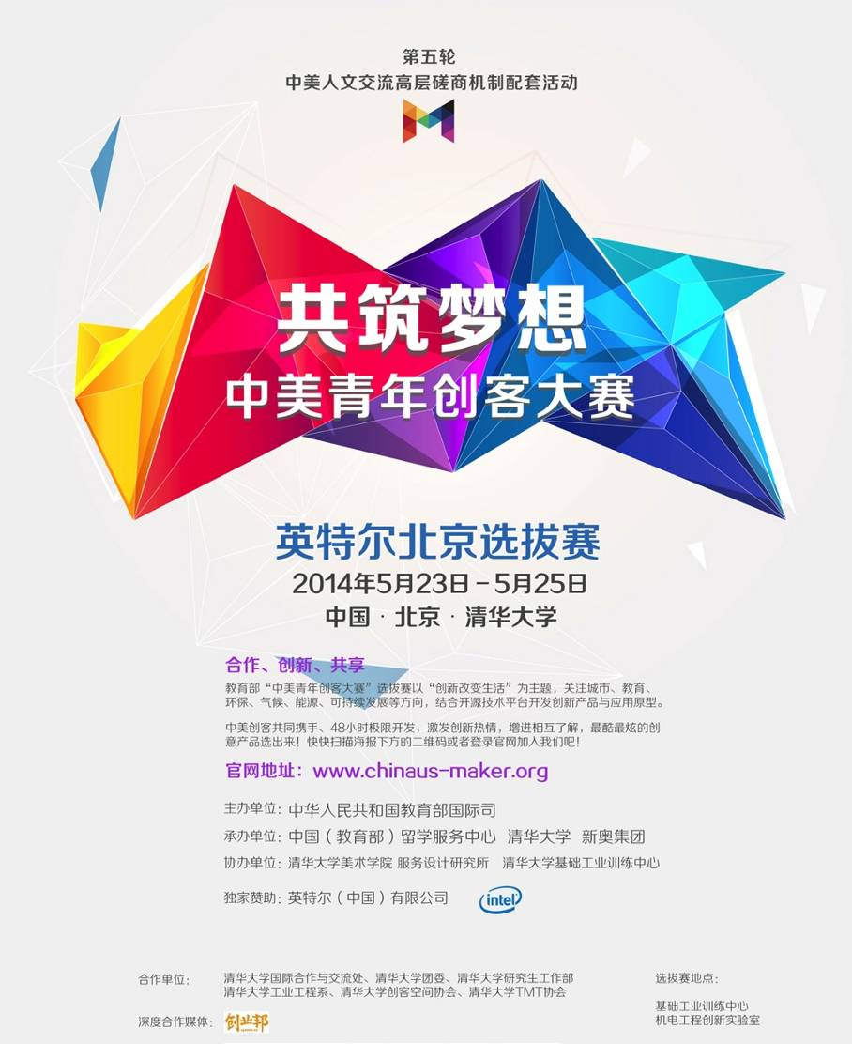
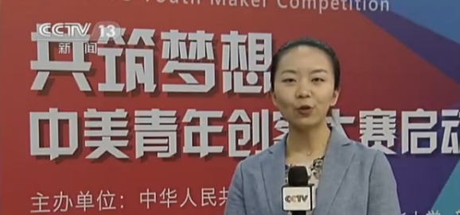
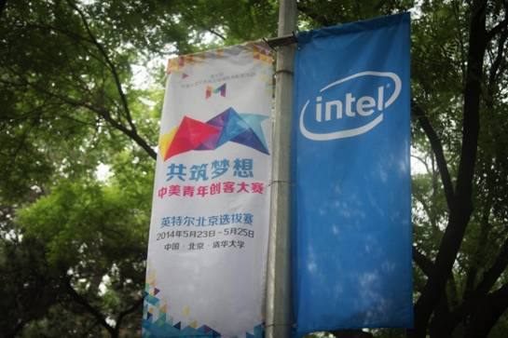
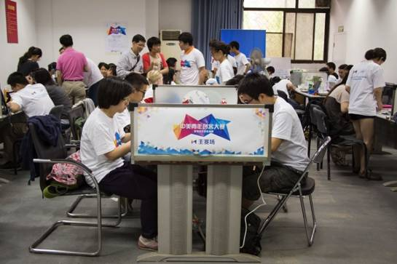
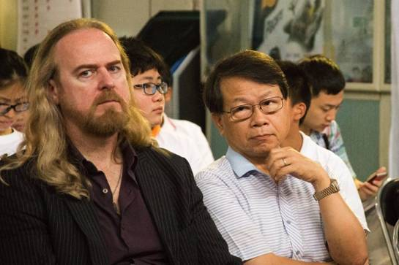
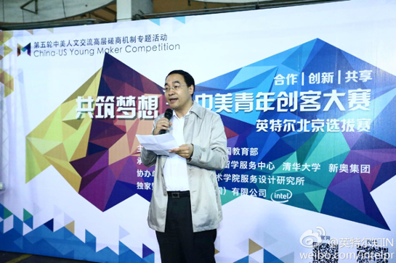
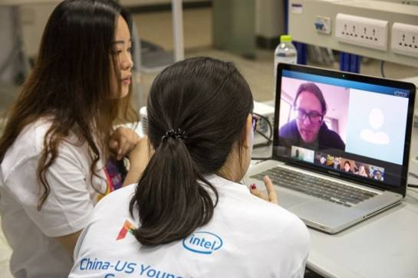
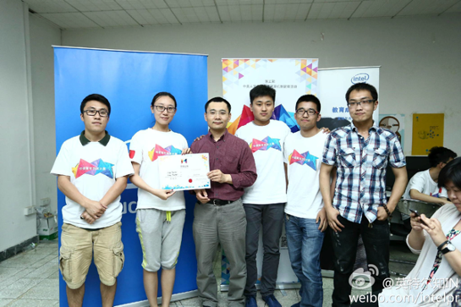

Slide 6
New Facility
Siu Kei Lee Tech Building. i-Center to be open in May, 2015. A platform for practices of innovative education.

Slide 7

Innovation Education Strategy
Courses
Integrating resources, to form new courses and curriculum
Self-driven courses
Activities
International exchange of ideas and people
On-campus maker activities and maker culture
Projects
Trans-disciplinary projects with global vision
Critical social challenges, such as energy, environment, medical care, urbanization…
Notes:
7

Slide 8
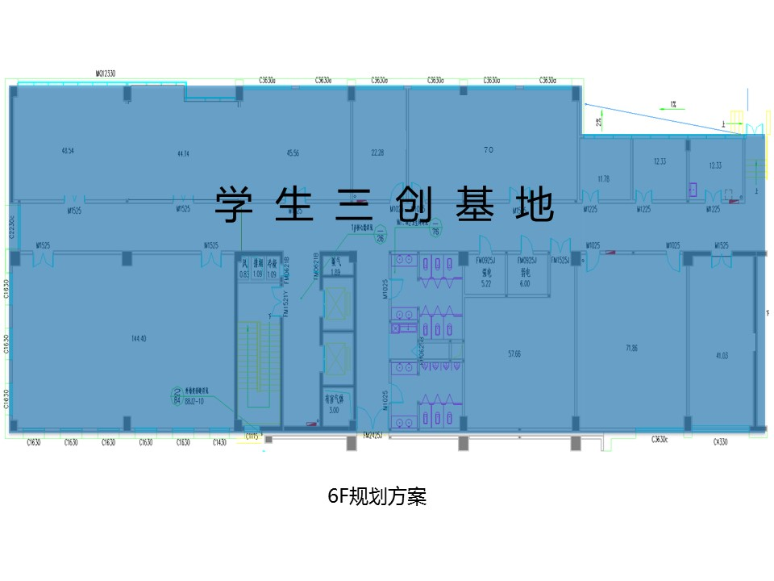
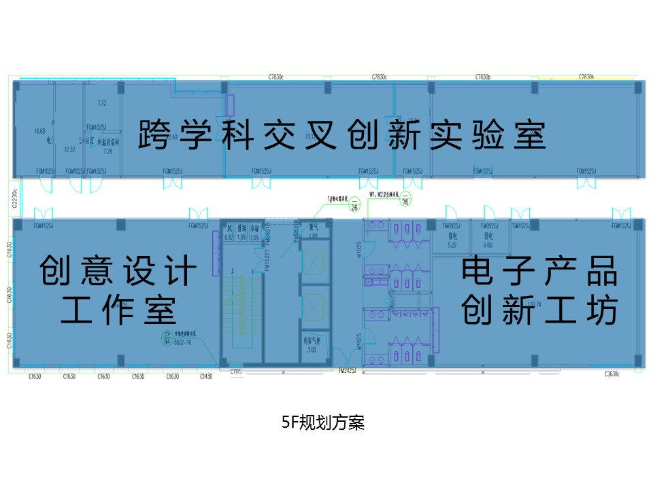
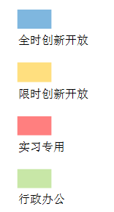
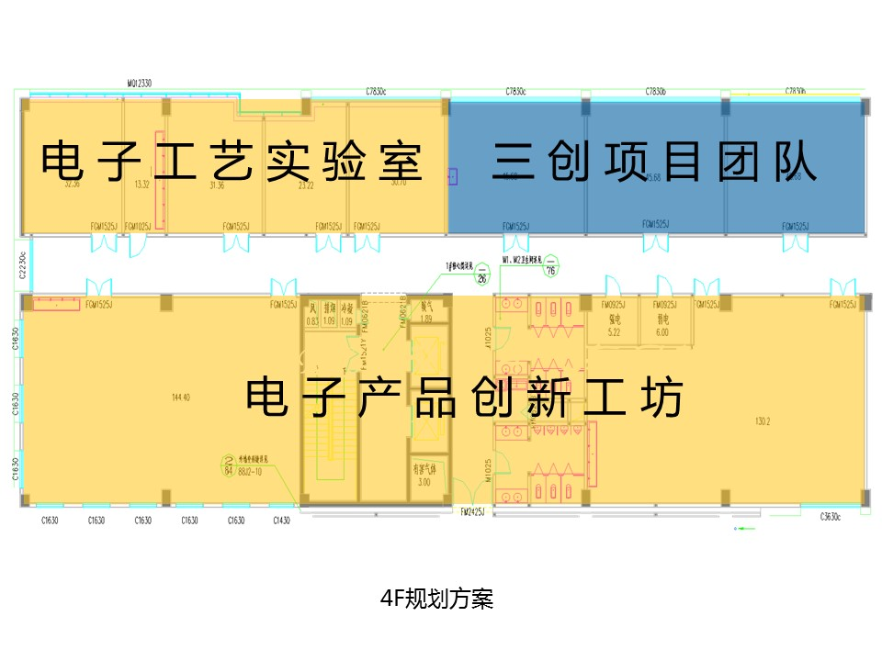
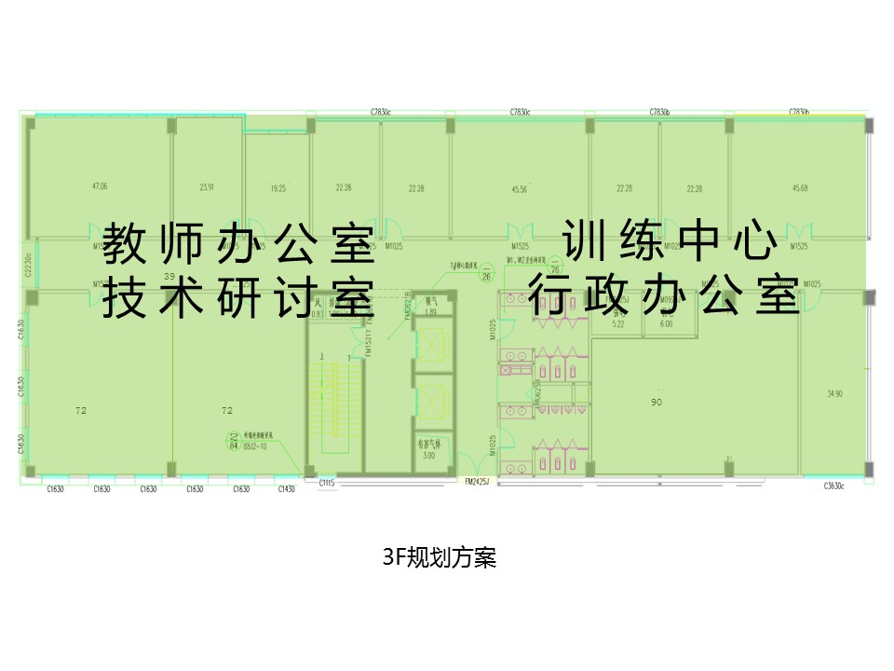
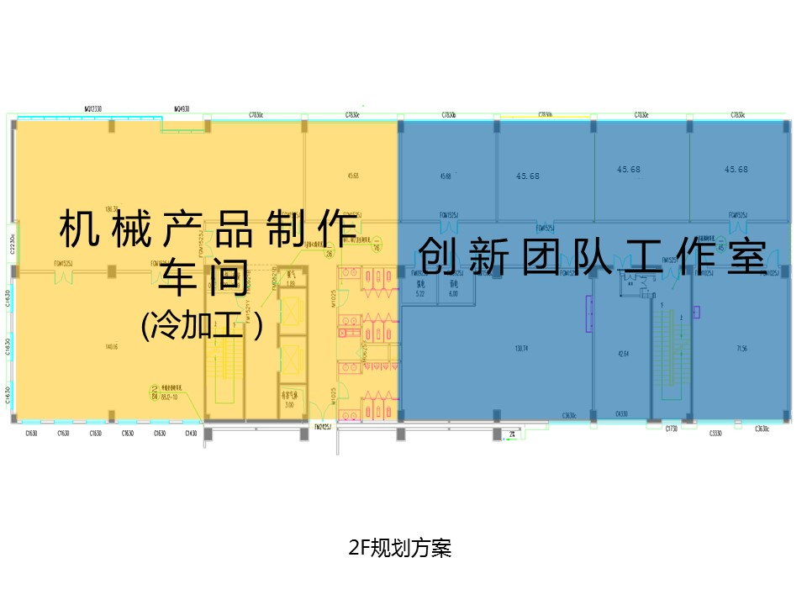
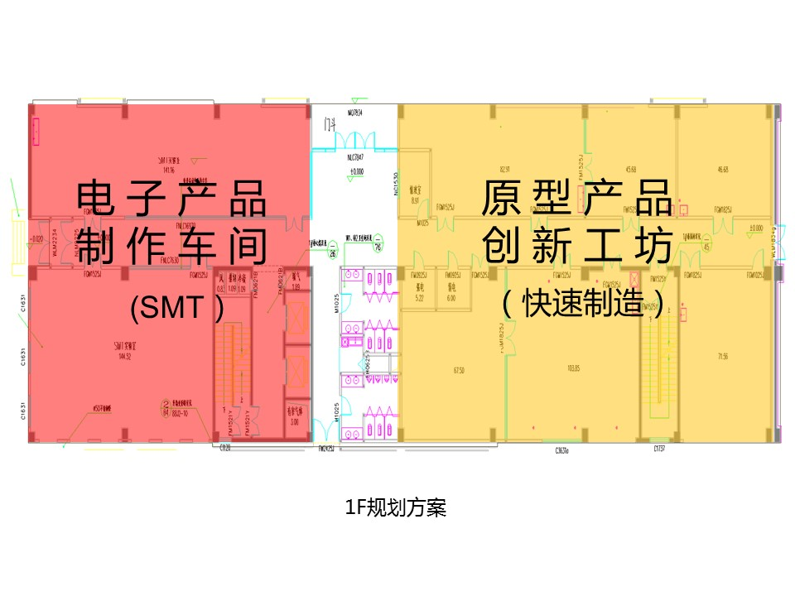
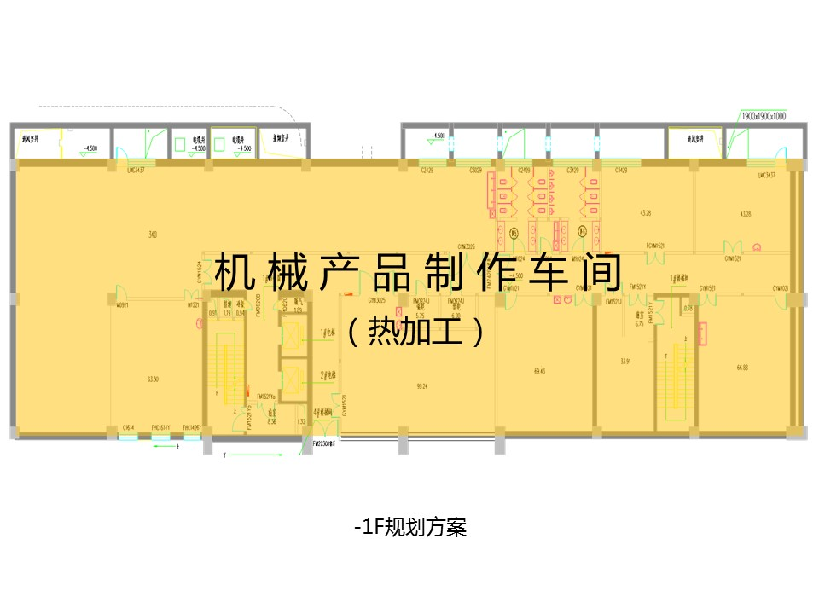
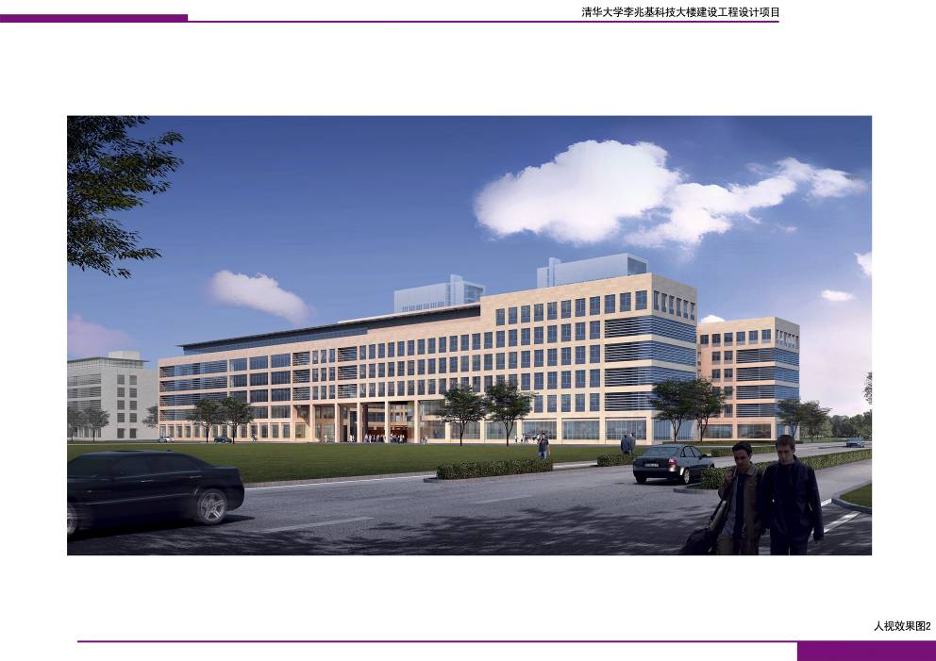
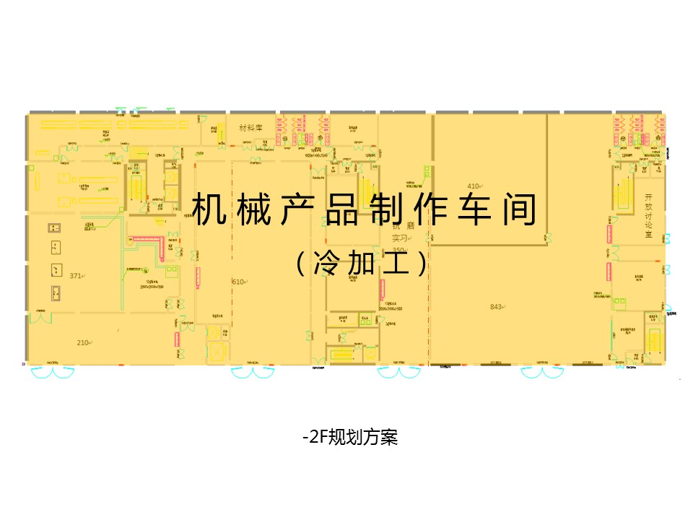
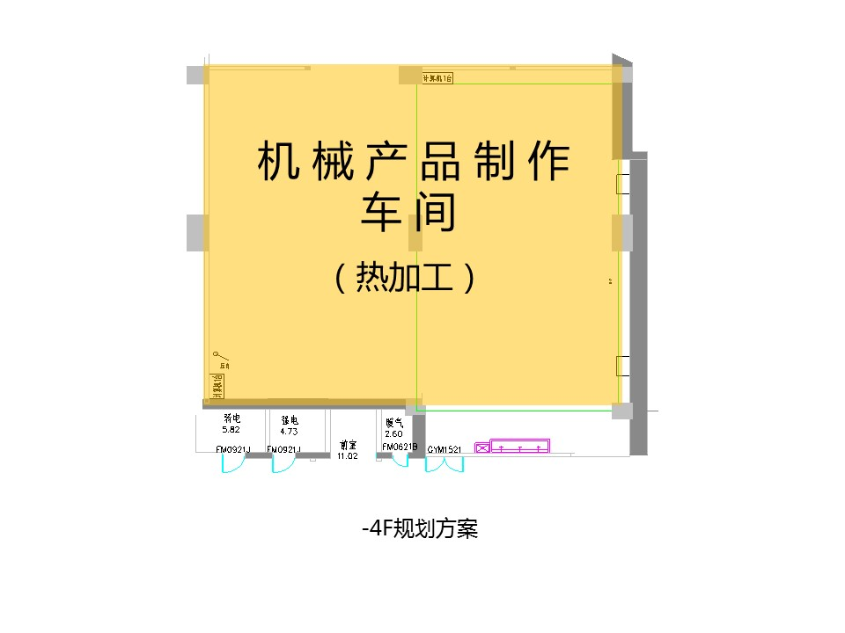
Floor plan for new building
F6
1. Innovation projects
- Product development, SRT projects
- Student clubs
2. Course and Activities
- Course, training programs
- Design & make
- Lectures, salons
- Challenges and Contests
3. Engineering practices and training
- Engineering practices, exploratory course
- Innovation presentations
- SRT supports, projects
Collaborative Innovation
F5
Full-time open
F4
Half-time open
F3
Training
F2
Administration
F1
Fundamental Training
B1
B2
B4

Slide 9
i-Center Maker Space

Slide 10
Faculty structure
University administrative level
Department level
Strategic Committee
Faculties interested in innovation
Hackers in residence, experts, entrepreneurs
Organization Committee
Cordination
Full-time
Teachers
Mentors*
Hackers in Residence#
Part-time
Mechanics
IT engineers
Volunteers, TAs, RAs
General Volunteers
Voluntary
*Mentor/Fellow, from various departments
#Hackers in Residence, from various countries

Slide 11
1 Maker Space + 10 Labs
Teams
Maker Space
Demonstration
Online course
Maker education
Maker activities
Maker contests
Clubs
Development
Ideas
Strategic Committee
Mentorship
Resources
Training
Guidance
Extreme Learning Process
Design and Tech
Maker education
Robotics
Motion Media
Organizing
Product
iteration
EE innovation
F…
G…
H…
I…
Incubation
Prototyping
Manufacturing
Fundamental Industry Training
Specilized Manufacturing Advanced Manufacturing

Slide 12
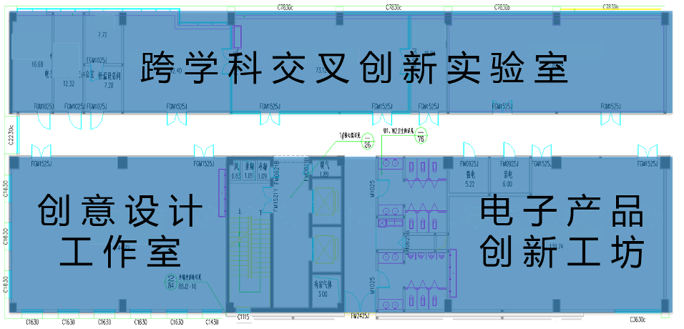
Innovation Lab Program
F6
F5
F4
F3
F2
F1
2 courses
Training
Maker activities
Products
B1
Evaluation
Lab
Lab
Lab
……
B2
Proj. Fund
Facilities
HR
Social resources
B4

Slide 13
Collaboration with Colleges and Depts.
Material
Precision Equipment
Mechanical Engineering
Electronics Engineering
Art school
Environment Engineering
……
Departments, collages, labs
Training platform
Collaborative achievement feedback
Teachers, courses, projects
Cross-disciplinary evaluation
i-Center
Trans-disciplinary labs

Slide 14
Equipment and Facilities
Abundant facilities
Handicrafts
Assembly
Woodcrafts
Electronics
Prototyping
Laser cutting
3D printing
Milling
Advanced manufacturing
CNC Center
Production line
Robotics
Cloud services
Online manufacturing
Cloud computing
Cloud data storage
Teleconference
Global maker collaboration

Slide 15



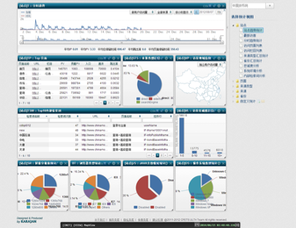

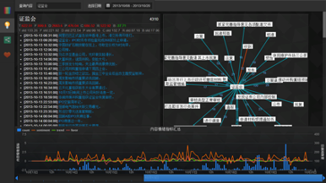




Outcome-based Education
Information
security
Collaboration
tools
Online sharing
Data analysis
Cloud services
Notes:
支撑考核，培养诚信
形成跨界创新的众筹模式
各个地区，各个产业，各个年龄阶段
清华不在是一个356公顷土地所框定的物理层面的大学，
而是能够响力延展到社会的各个角落的
抓住未来的年轻人才

Slide 16
Right time, right place
Cross-disciplinary practices and collaboration
Exploration,
Implementation

